Slide 1


B.Tech
Project
Predictive Modeling for Combined Cycle Power Plant Using Gradient Descent
Student detail – Dhanraj Avhad
21mc3005

Slide 2

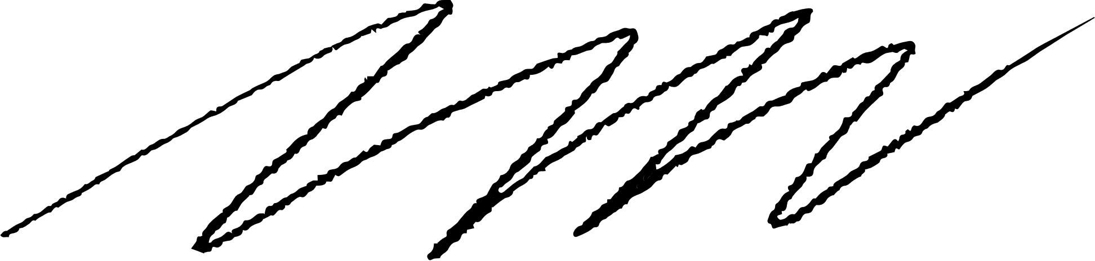
Outline
Problem Description
Data Overview
The Role of Gradient decent method
Proposed Approach
Results and Discussions
Conclusion
Avenues of Future Work

Slide 3


Problem Description
Use the Gradient Descent method to build a model that can predict the net hourly electrical energy output of Combined Cycle Power Plants.
The dataset from a Combined Cycle Power Plant. This dataset comprises hourly measurements from various ambient sensors around the plant, capturing key variables such as temperature, pressure, humidity, and exhaust vacuum. Each data point represents the average ambient conditions over an hour, totaling 9568 observations spanning six years of operation from 2006 to 2011..
Importance- The decisions you make, guided by our predictive model, directly influence how much electrical energy the plant will generate in the upcoming hour.

Slide 4
Data Overview
Attribute Information:
Features consist of hourly average ambient variables
- Temperature (T) in the range 1.81°C and 37.11°C,
- Ambient Pressure (AP) in the range 992.89-1033.30 milibar,
- Relative Humidity (RH) in the range 25.56% to 100.16%
- Exhaust Vacuum (V) in the range 25.36-81.56 cm Hg
- Net hourly electrical energy output (EP) 420.26-495.76 MW
The averages are taken from various sensors located around the plant that record the ambient
variables every second. The variables are given without normalization.
We have two dataset one is train and other is test dataset.

Slide 5

The role of Gradient Decent method
Gradient Descent is known as one of the most commonly used optimization algorithms to train machine learning models by means of minimizing errors between actual and expected results. Further, gradient descent is also used to train Neural Networks.
In mathematical terminology, Optimization algorithm refers to the task of minimizing/maximizing an objective function f(x) parameterized by x. Similarly, in machine learning, optimization is the task of minimizing the cost function parameterized by the model's parameters. The main objective of gradient descent is to minimize the convex function using iteration of parameter updates. Once these machine learning models are optimized, these models can be used as powerful tools for Artificial Intelligence and various computer science applications.
In our case, it's like our compass, guiding the model to the optimal set of parameters that result in the most accurate predictions
.

Slide 6
Proposed Approach
Our Approach: The backbone of our methodology lies in the utilization of optimization methods, primarily Gradient Descent or Conjugate Gradient Descent. These techniques serve as the backbone of our journey toward fine-tuning model parameters for accurate predictions. They act as the architects, shaping our model to align with the complex dynamics of the power plant."
"Feature Scaling for Improved Convergence: Recognizing the diversity in the ranges of our ambient variables—temperature, pressure, humidity, and exhaust vacuum—we incorporate Feature Scaling. This crucial step ensures that no single variable dominates the optimization process, promoting a balanced convergence of our model. It's akin to ensuring each player in a team has an equal say in the game."
"Hyperparameter Tuning: Just like tuning an instrument for the perfect melody, we fine-tune the learning rates and iterations. The learning rate determines the size of our steps during optimization, and the number of iterations sets the depth of our exploration. It's a delicate balance—we aim to be neither too hasty nor overly meticulous, ensuring our model converges optimally.
.

Slide 7

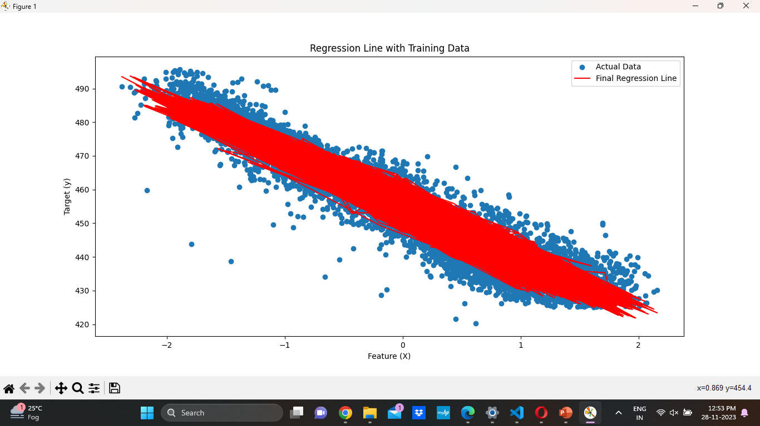
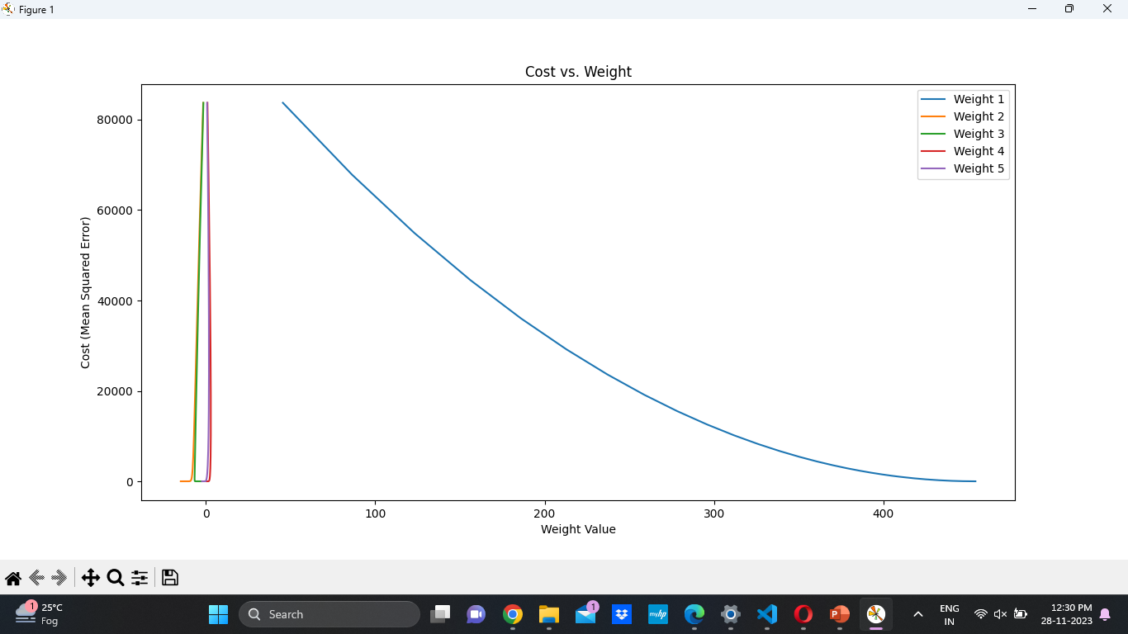
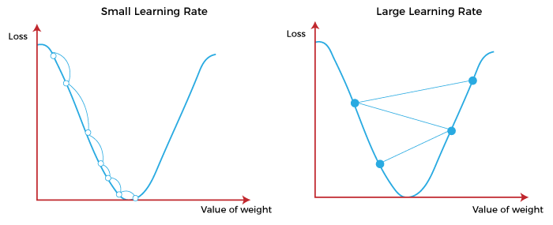
Results
5.1 Model Performance Metrics
After implementing the Gradient Descent algorithm on the training set, the model's performance was evaluated using the coefficient of determination (R-squared). The obtained R-squared value on the training set was 0.928. This suggests that approximately 92% of the variability in the net hourly electrical energy output is explained by our model.
5.2 Impact of Learning Rates
Different learning rates were tested to understand their impact on the model's convergence and performance. The following learning rates were experimented with: 0.01, 0.1, 0.8178. The R-squared values corresponding to each learning rate were as follows:
Learning Rate 0.01: 0.82
Learning Rate 0.1: 0.928
Learning Rate 0.8178: 0.43
Observations:
A learning rate of 0.1 resulted in the highest R-squared value, indicating a good balance between convergence speed and avoiding overshooting.
Learning rates that were too small (0.01) led to slower convergence, while rates that were too large (0.8178) caused overshooting and reduced model accuracy.
.
.

Slide 8





Conclusion
The chosen learning rate of 0.1 and 5000 iterations resulted in the best model performance with an R-squared value of 0.928. These hyperparameters strike a balance between convergence speed and model accuracy.
This underscores the effectiveness of our predictive model.
Successful Application
The proposed approach was successfully implemented in a real-world power plant setting, demonstrating its practical viability and applicability.
The implementation process highlighted the importance of data collection, data quality, and model interpretation for successful power plant optimization.

Slide 9






Avenues of Future works
Further Exploration and Improvement
-Investigate the application of deep learning algorithms to capture complex relationships within power plant data.
-Explore real-time optimization techniques to adapt to changing operating conditions and energy demands.
-Develop robust model validation strategies to ensure the accuracy and reliability of optimization results.
Potential Enhancements
-Incorporate additional power plant data sources, such as sensor measurements and historical records, to enrich the model's input.
-Develop multi-objective optimization algorithms that consider various performance metrics simultaneously.
-Utilize explainable AI techniques to enhance the interpretability of model predictions and facilitate decision-making.
Additional Research Areas
-Investigate the application of optimization techniques for power plant maintenance scheduling and predictive maintenance.
-Explore the integration of power plant optimization with renewable energy sources for a more sustainable energy system.
-Develop optimization algorithms that consider environmental factors and emission reduction strategies.
Studio Shodwe

Slide 10

Thank you

Slide 11










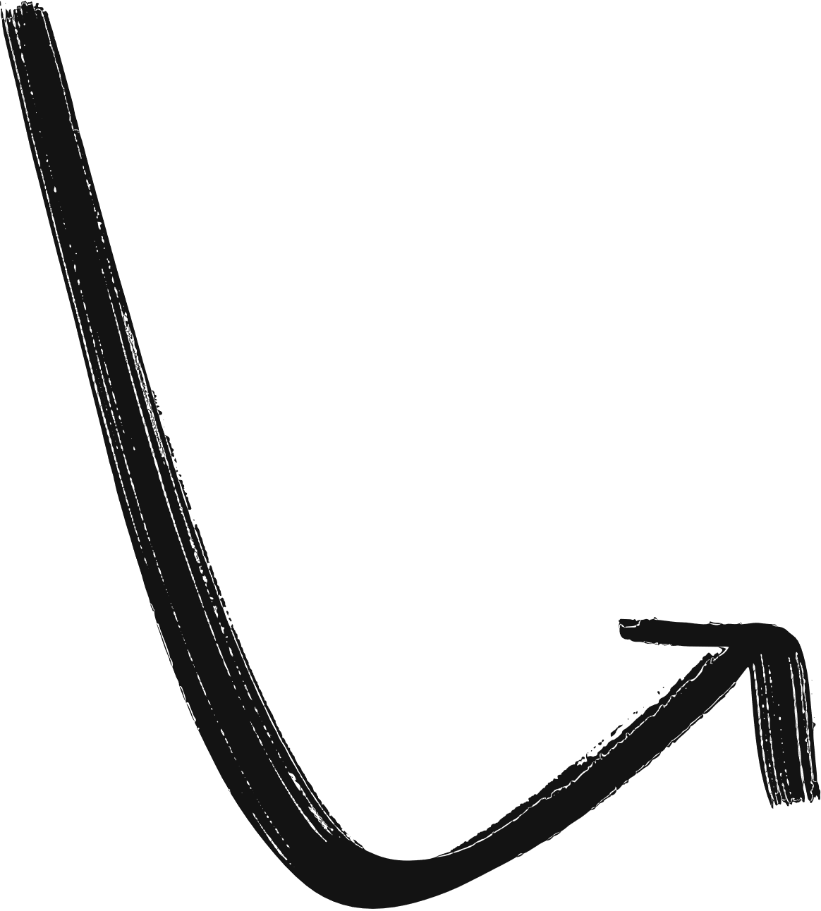

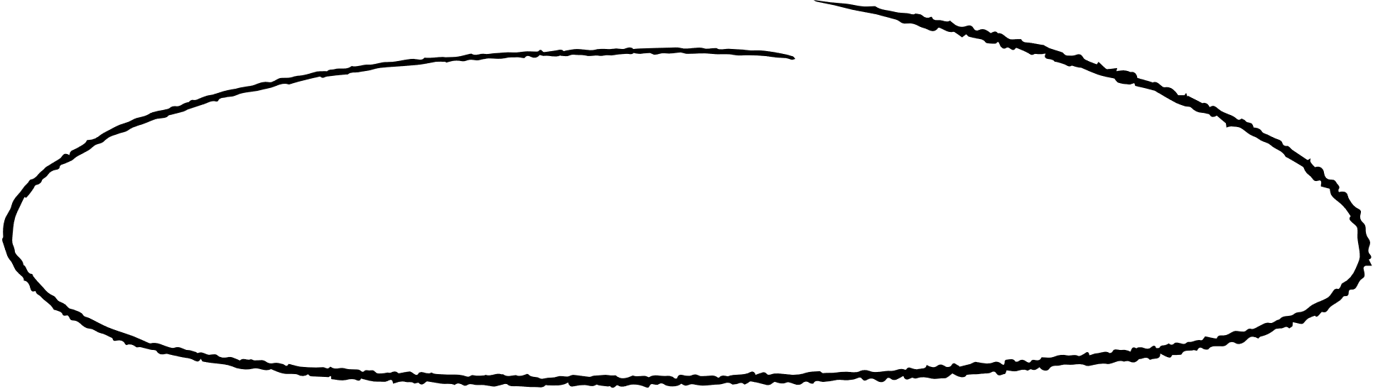
Resource page

